Slide 1
Fracture network generation with graph deep learning
Ana Tanaka, Philippe Renard, Julien Straubhaar, Xiao Xia Liang, Dany Lauzon

Slide 2
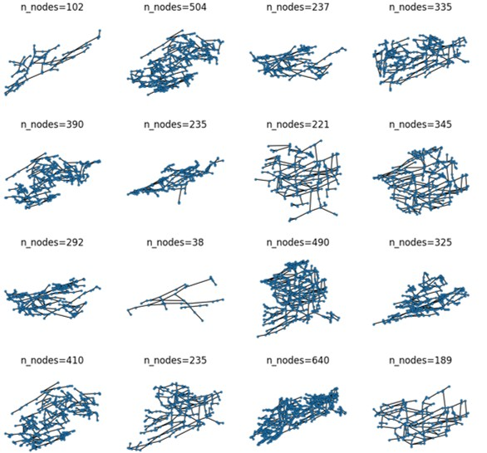
Collection

Slide 3
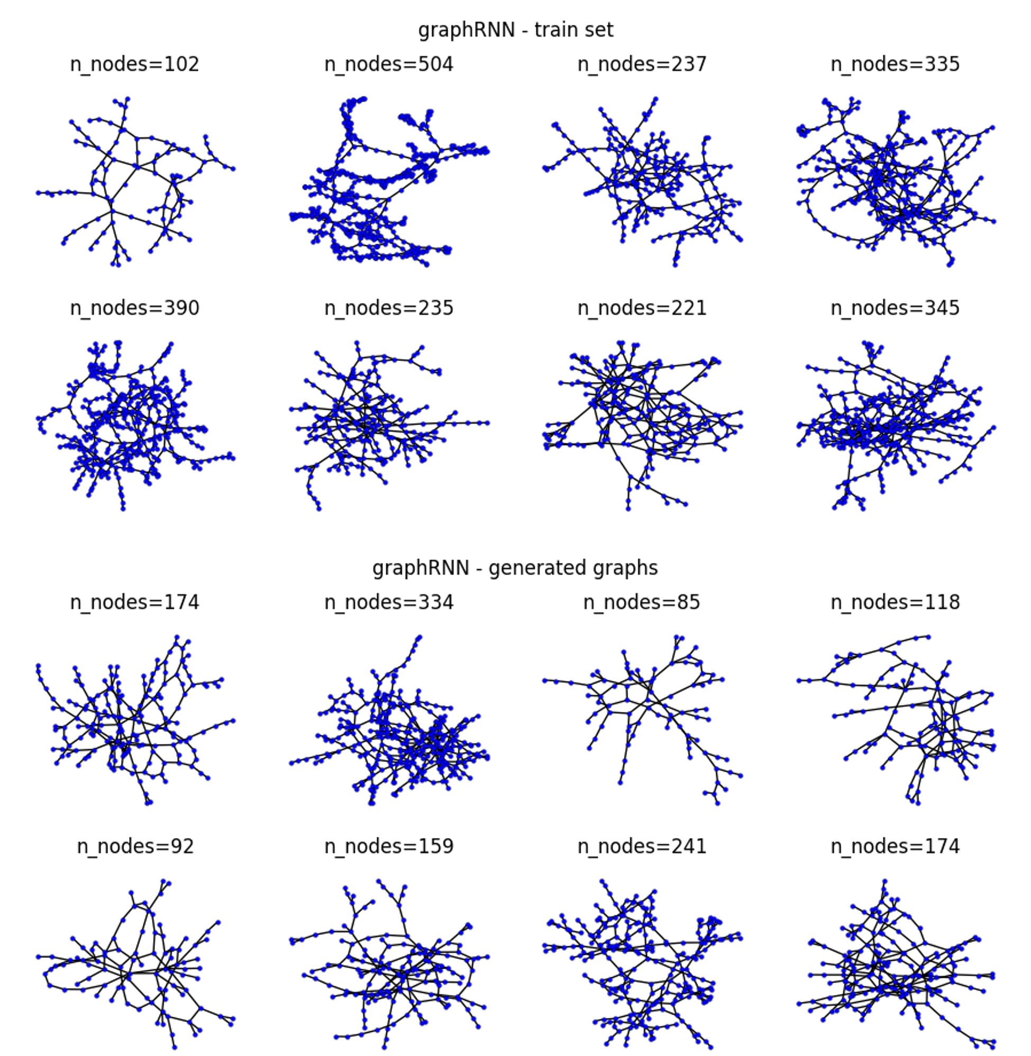
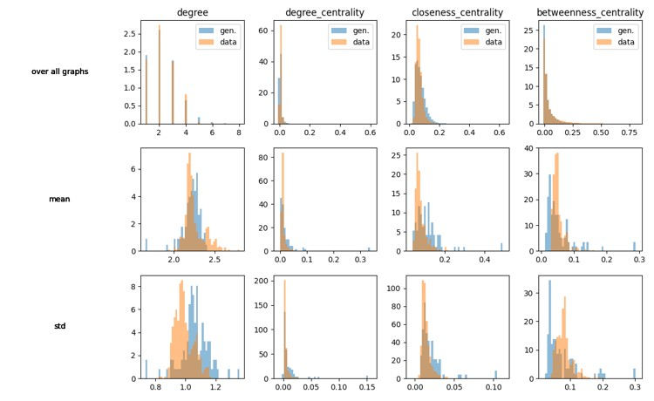
GraphRNN

Slide 4
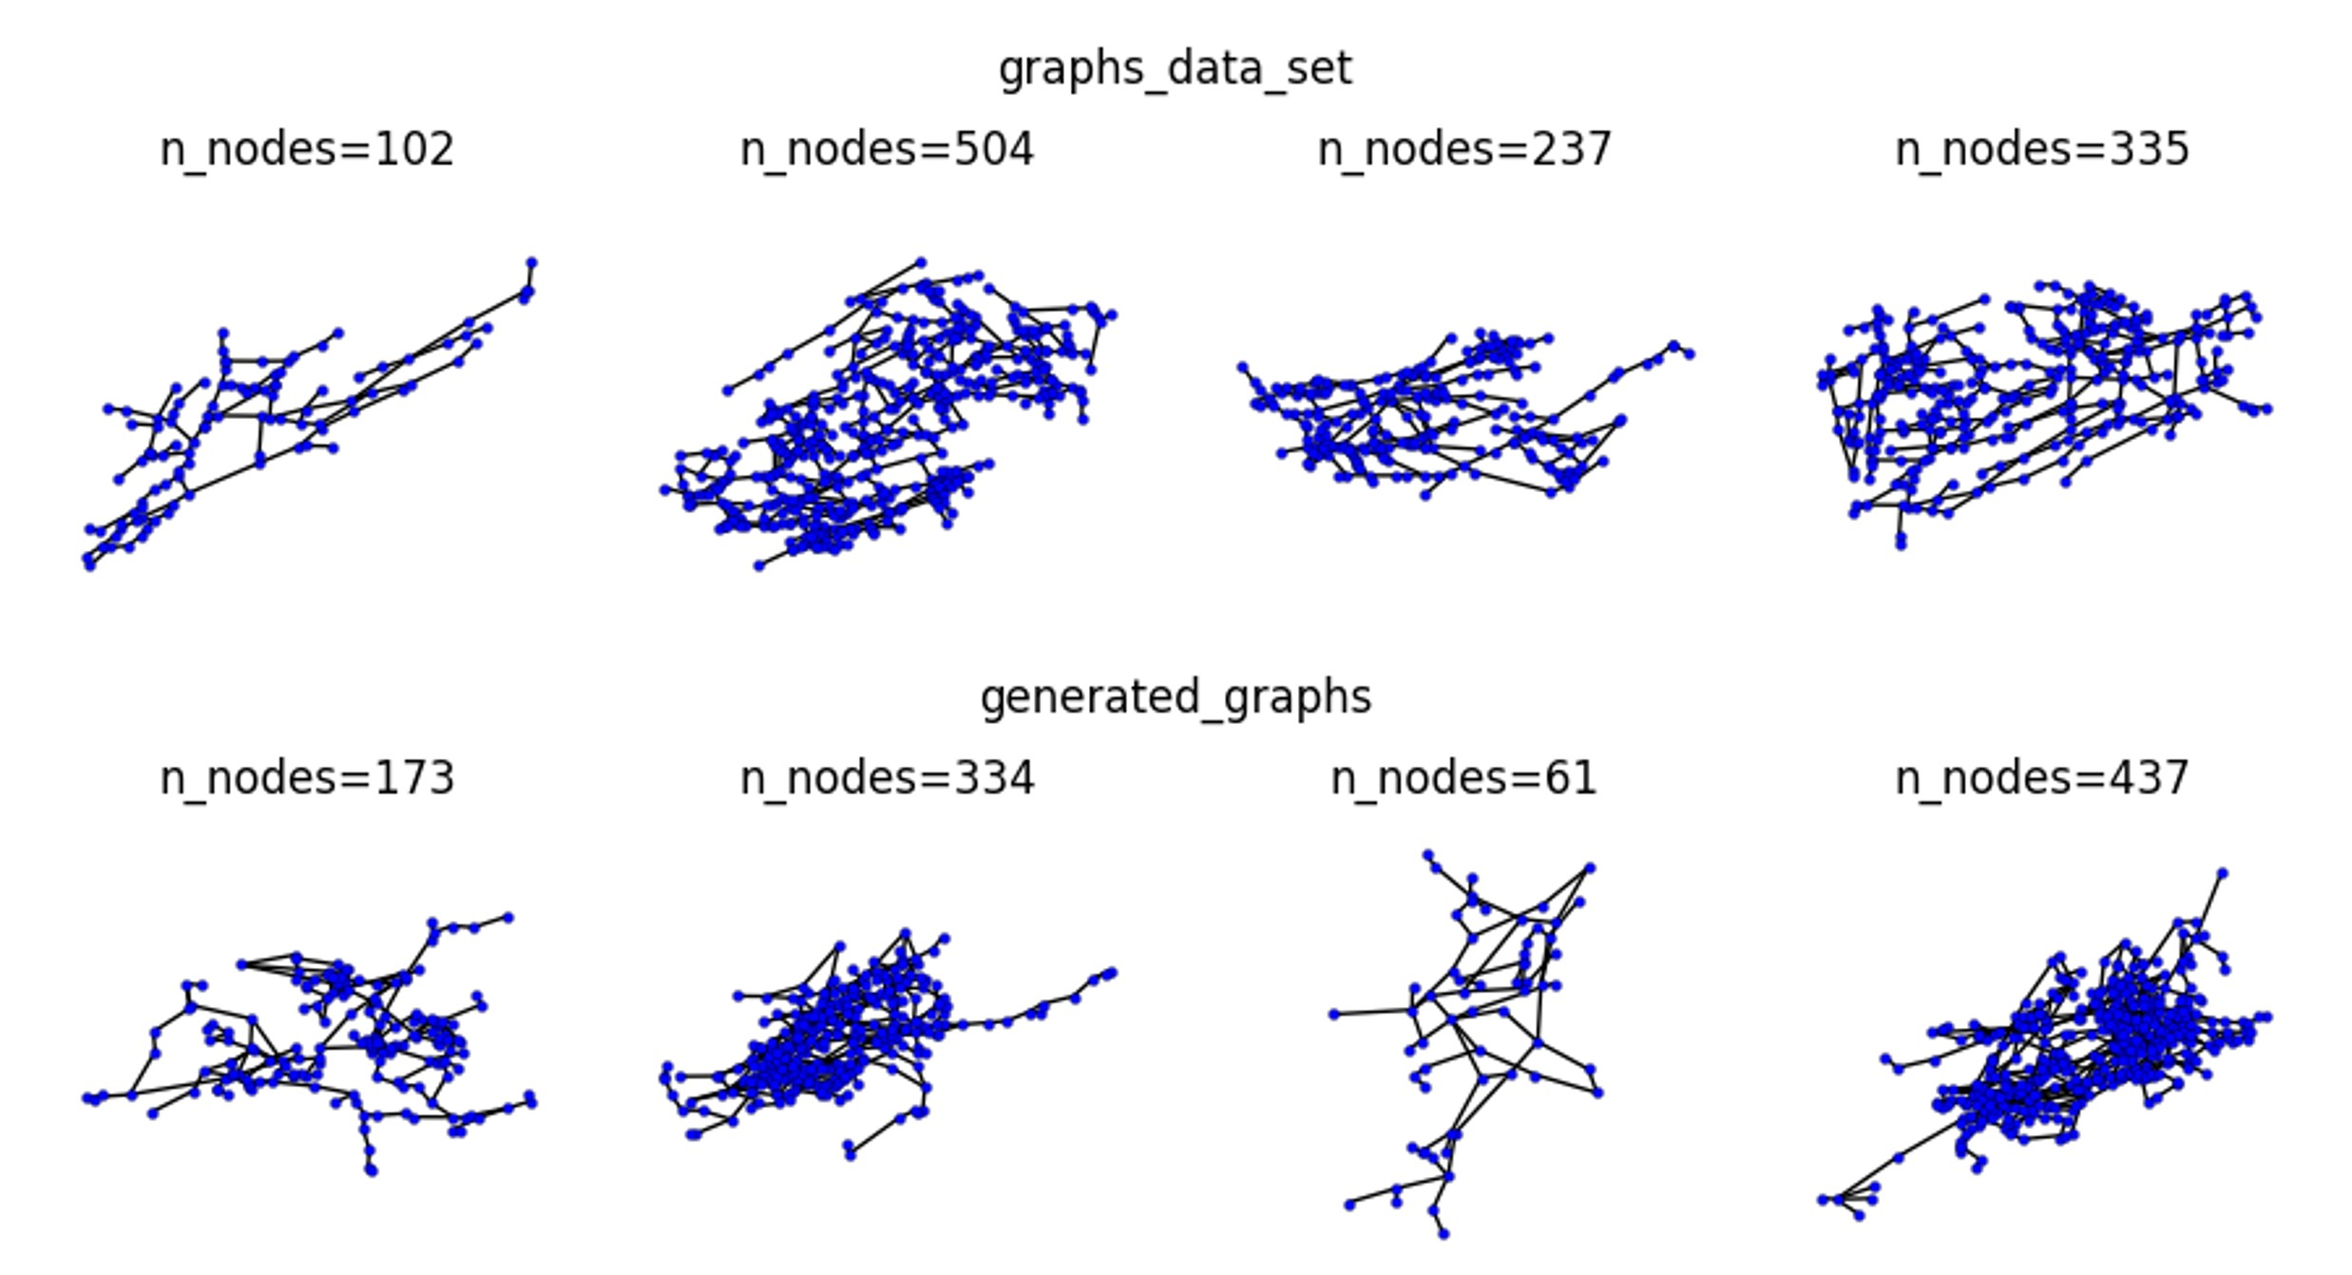
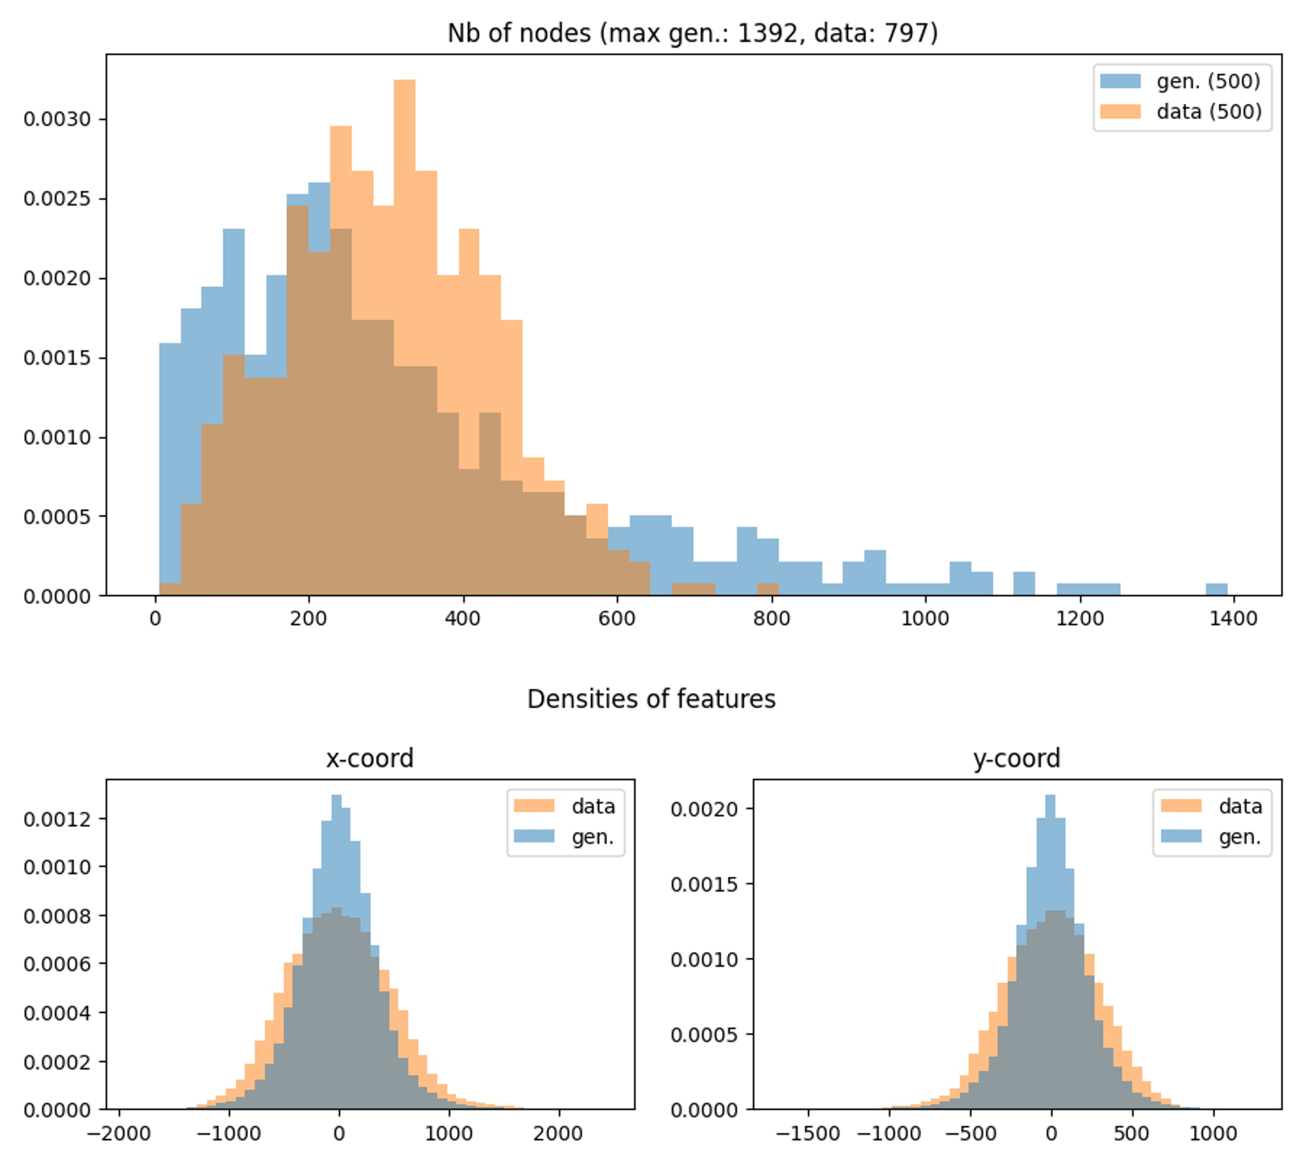
DDPM

Slide 5
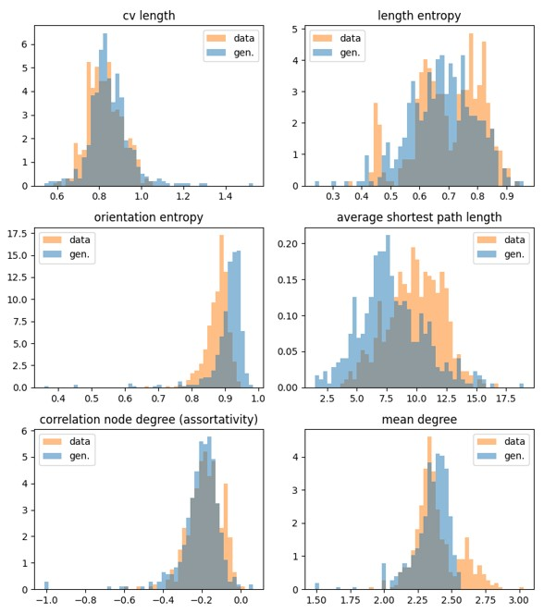
Stats Karstnet

Slide 6
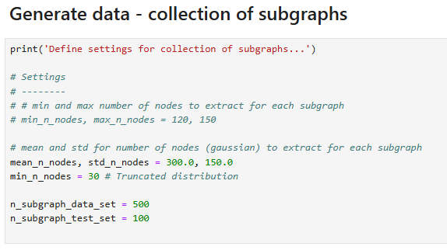
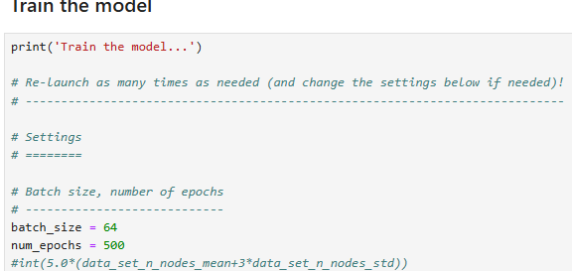
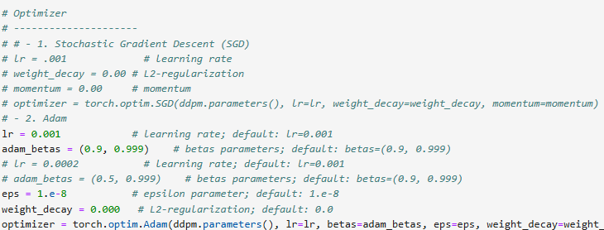
Tries
Higher amount of subgraphs for trainning (Data collection)
Change batch_size, epochs and learning rate (GraphRNN training) (DDPM training)
Forcing distance among nodes Energy guided diffusion (DDPM trainining)
Avoid crossing Crossing penalty (DDPM training)

Slide 7
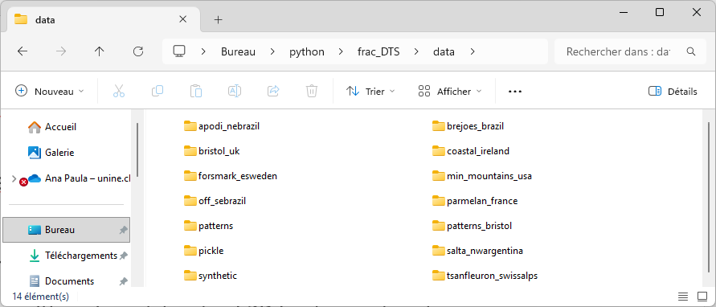
Ideas to improve the model
Changing parameters?
Retraining the diffusion model with a larger amount of fracture networks
Let the model learn with various datasets of 2D fracture networks
Then apply the weights to try to reproduce a new network from a specific one
Develop a new process to connect the edges with specific constrains
____________________________________________
Gathering open fracture network datasets
Transforming to graphs

Slide 8
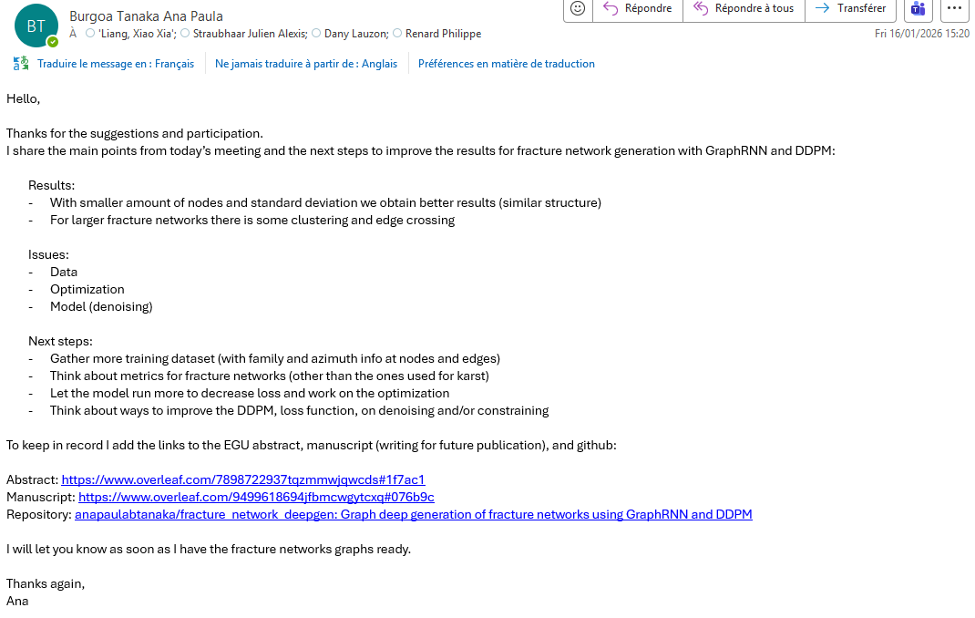
Minutes of meeting
16/01/2026 Videoconference 14:00 – 15:15

